Slide 1

Morten Knudsen Microsoft MVP, Cloud & Security Architect
Optimizing log ingestion in Microsoft Sentinel or how to save money

Slide 2

This presentation
https://mortenknudsen.net/wp-content/uploads/2024/10/Greek-Microsoft-Security-Community-1st-Meetup-with-Morten-Waltorp-Knudsen.pptx

Slide 3


Connect with me - Morten Knudsen
Blog:
aka.ms/morten (https://mortenknudsen.net)
Linkedin:
https://www.linkedin.com/in/mortenwaltorpknudsen
X / Twitter:
https://twitter.com/knudsenmortendk
Github:
https://github.com/KnudsenMorten
Mail:
mok@mortenknudsen.net

Slide 4

Topics
Data Ingestion Monitoring & Analysis
Monitoring of Azure Cost
Analyzing Log Events
Data Transformation
Table Transformation
Workspace Transformation
Endpoint Transformation
Structure of LA Workspaces
Data Retention
Plans (LogAnalytics vs. Basic vs. Auxiliary)
Alternative Long-Term Retention

Slide 5
Data Ingestion Monitoring & Analysis

Slide 6
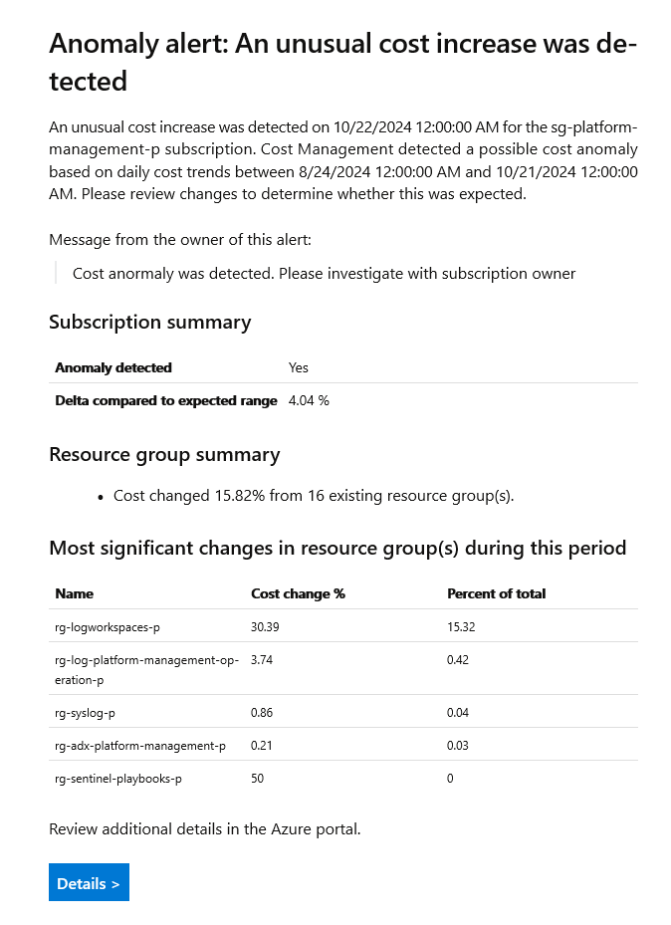
Cost Monitoring Anomaly Detection Machinelearning Cost anomalies are evaluated for subscriptions daily and compare the day's total usage to a forecasted total based on the last 60 days to account for common patterns in your recent usage. For example, spikes every Monday. Anomaly detection runs 36 hours after the end of the day (UTC) to ensure a complete data set is available. The anomaly detection model is a univariate time-series, unsupervised prediction, and reconstruction-based model that uses 60 days of historical usage for training, then forecasts expected usage for the day. Anomaly detection forecasting uses a deep learning algorithm called WaveNet. It's different than the Cost Management forecast. The total normalized usage is determined to be anomalous if it falls outside the expected range based on a predetermined confidence interval.

Slide 7
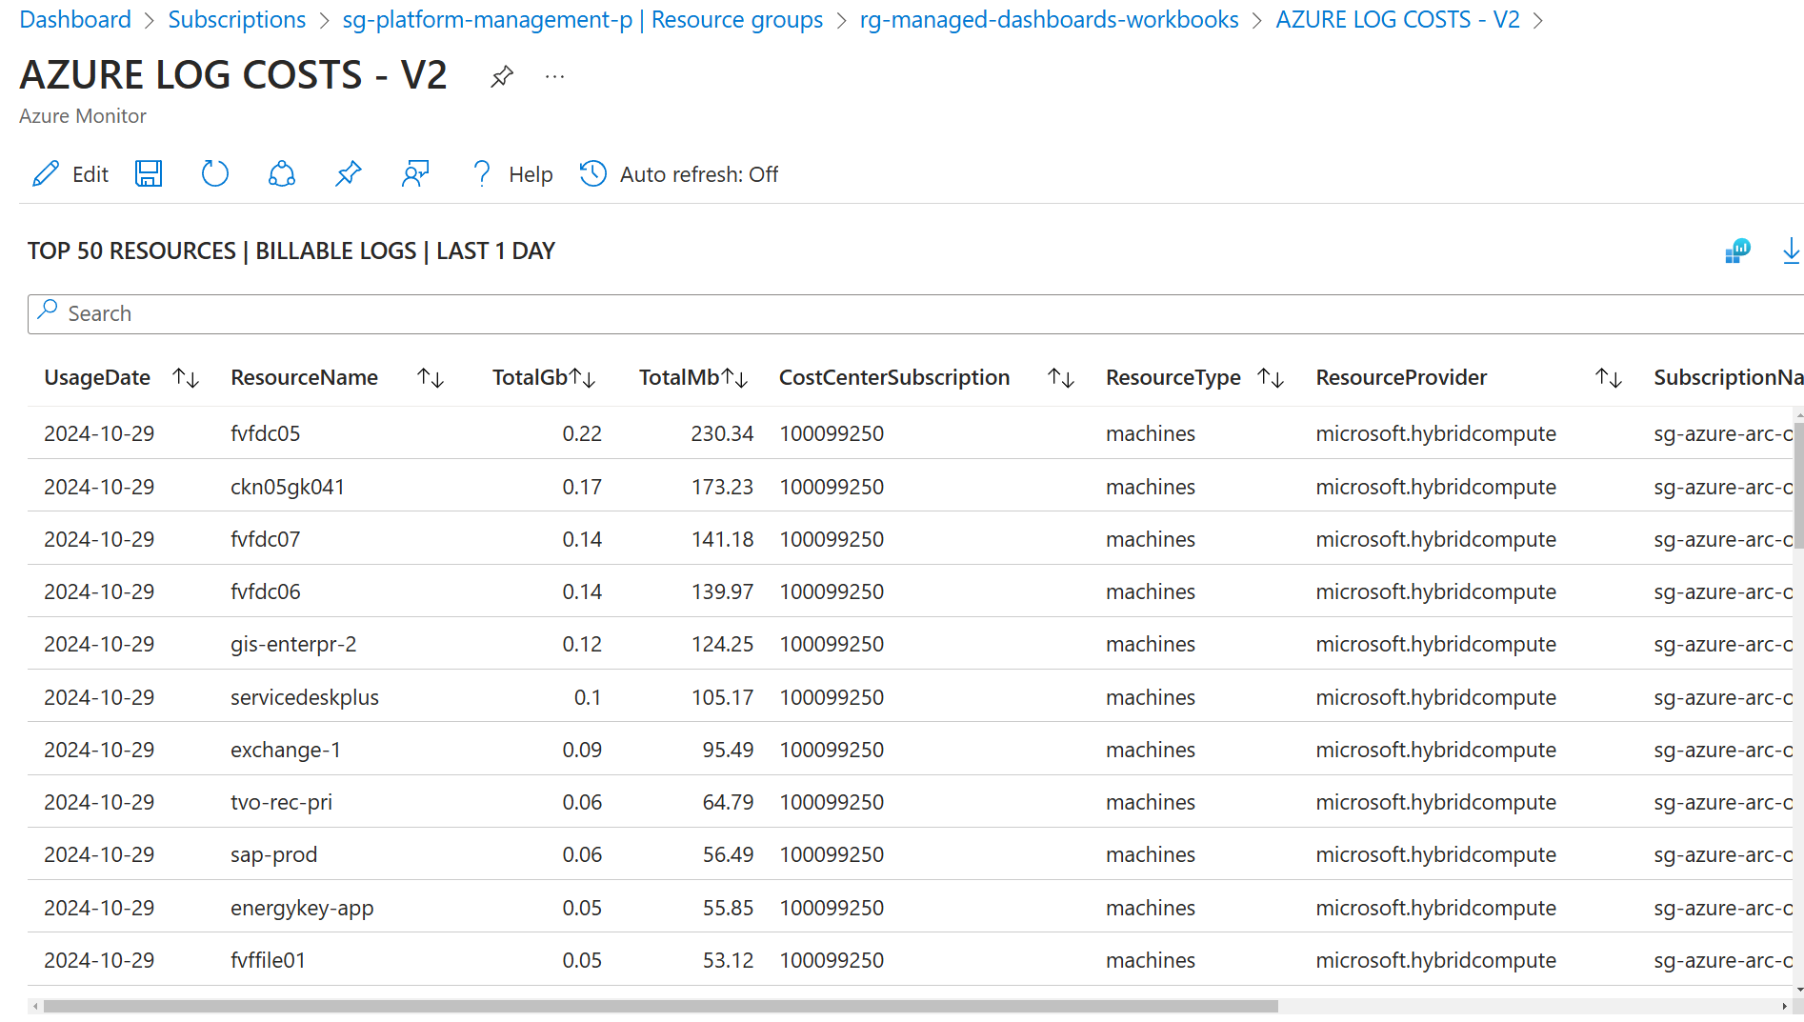
Data Ingestion Analysis (Monitoring)
Look At Your Data -> Issues in your environment
Usage and Estimated Costs
Insights
Workbook (sample)

Slide 8
Data Transformation

Slide 9
Data Transformation
Understanding Architecture of LogAnalytics “v2”
Backend
Table Transformation
Workspace Transformation
Endpoint Transformation
AMA (coming !)
API – ClientInspector

Slide 10
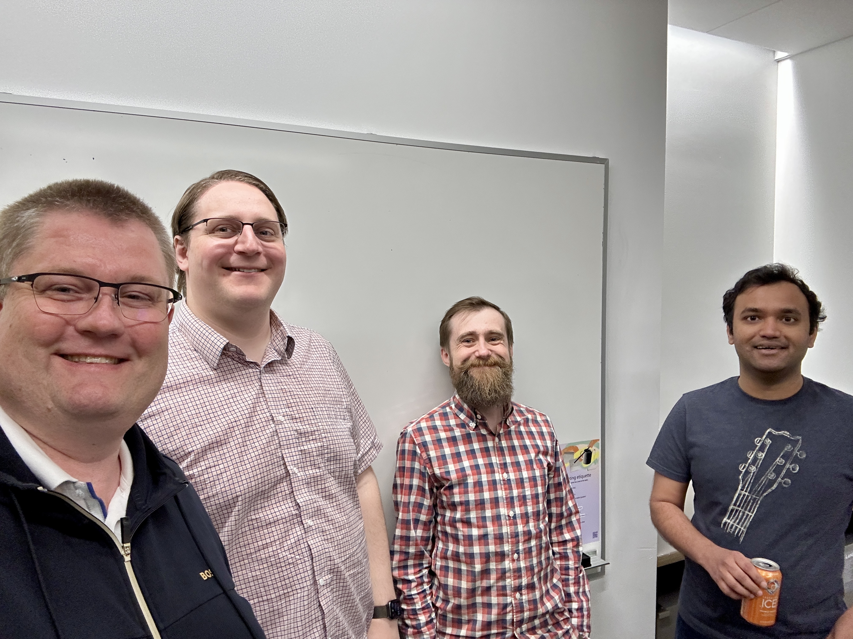
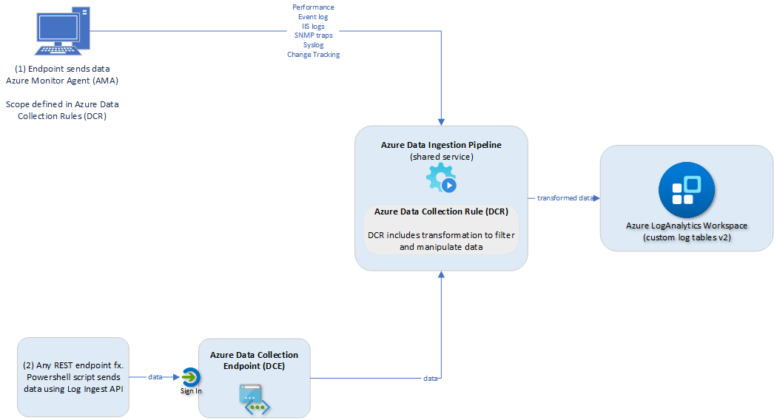

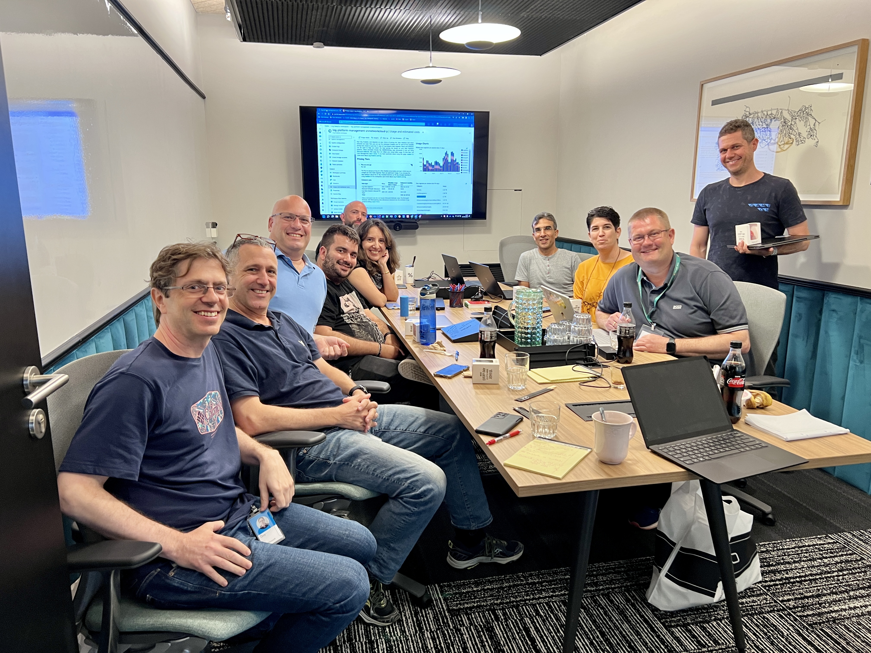
Azure DCR PMs &
Dev Lead, Seattle, USA
Azure Pipeline PMs, Seattle, USA
“V2”
Azure Pipeline
DCR & DCE
Transformation
Custom tables (v2)
Azure LogAnalytics PMs, Israel

Slide 11
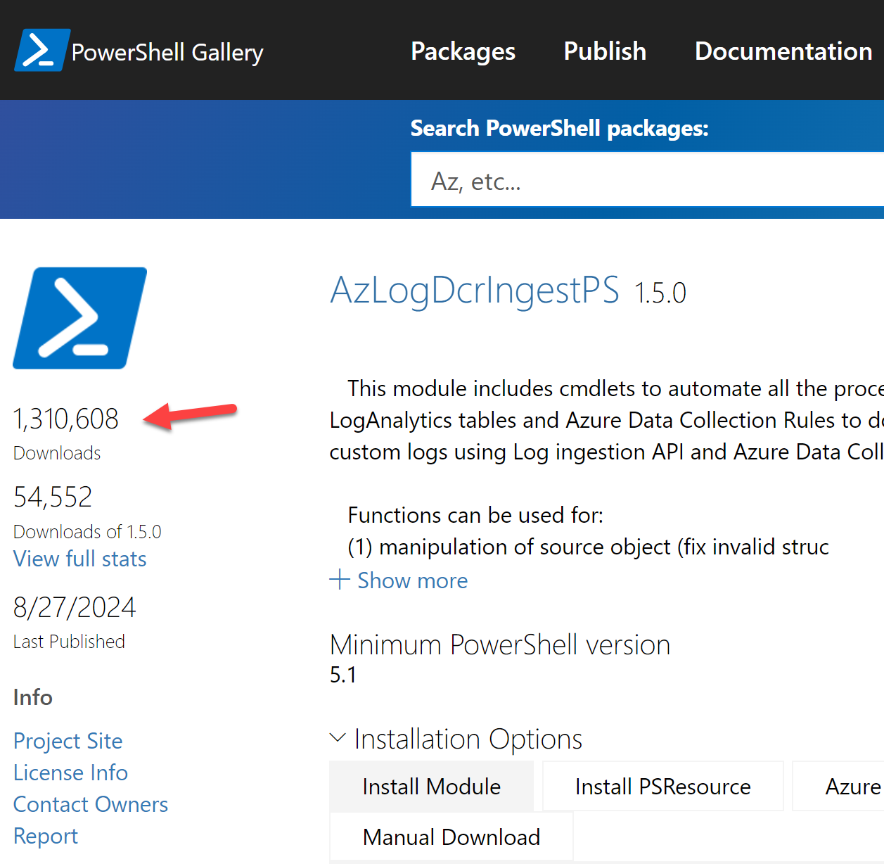

Challenges with v2 technologies
25 functions
+6500 lines of code
Requirements / Dependencies
Creation of DCR + tables before sending data
Data Collection EndPoint must exist
Schema for data must be defined in both DCR and v2 custom table
Azure seconds - timing / delays – dependencies
Architecture
Naming conventions & limitations / Prohibited names
Handle new properties in source object (merge, overwrite)
Property changes -> True (string) → True (Boolean) – “internal server 500”
Upload changes (32 mb -> 1 mb) per JSON (batches, calculations)
DCR limitations with large schema
Platform – no-internet access, TLS incompatibility
Data manipulations of source data (filtering, remove)
“Wrapper of standard features”

Slide 12
Data Transformation (BackEnd)
Workspace Transformation
https://mortenknudsen.net/?p=1436
Table Transformation using DCR
https://mortenknudsen.net/?p=1440

Slide 13
Data Transformation (FrontEnd)
Endpoint Transformation - Sample (ClientInspector)
AzLogDcrIngestPS (Github)
AzLogDcrIngestPS (PS Gallery)
ClientInspector
Real example with 43% cost savings on Sentinel log-costs: How to exclude Syslog log-events from banned IPs using AbuseIPDB-service with integration to firewalls
https://mortenknudsen.net/?p=450

Slide 14
Structure of LA Workspaces

Slide 15
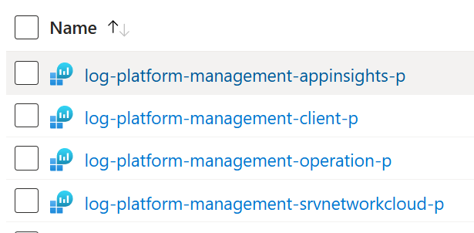
Structure of your LA Workspaces Central Hub

Slide 16
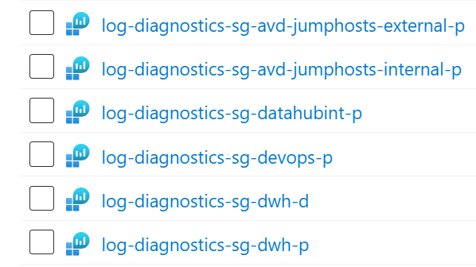
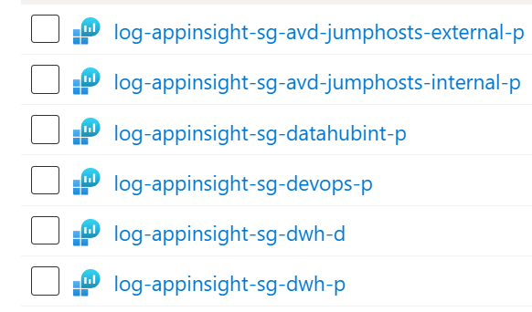
Structure of your LA Workspaces Decentral / Team

Slide 17
Data Retention
LA Plans & ADX

Slide 18

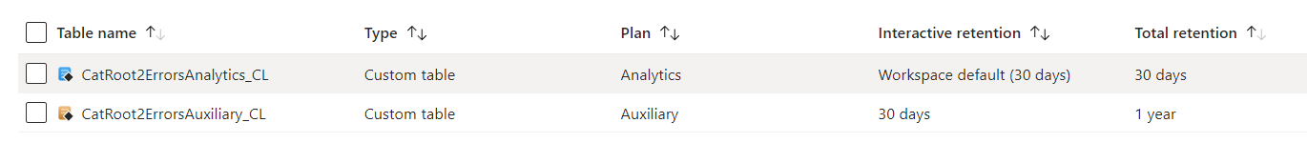
Auxiliary Logs (public preview) high ingestion (verbose-logging) storage access logs, NetFlow logs, proxy logs, IoT logs, Firewall logs, CSV-files, TXT-files

Slide 19
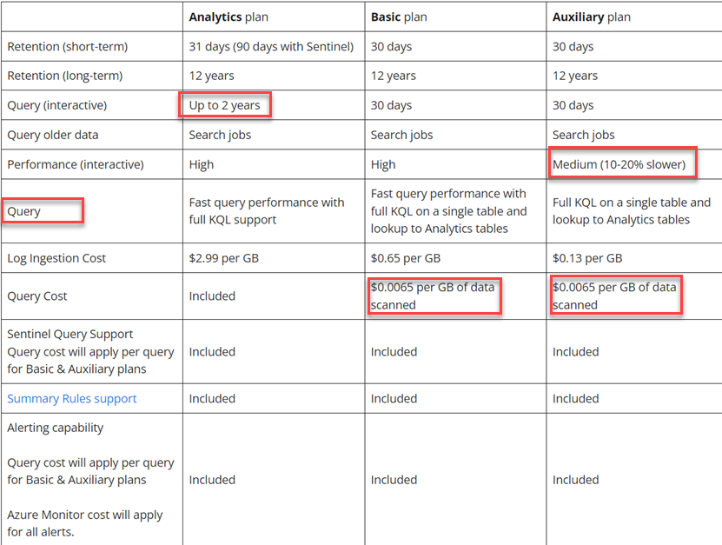
Feature Comparison
Of Plans

Slide 20

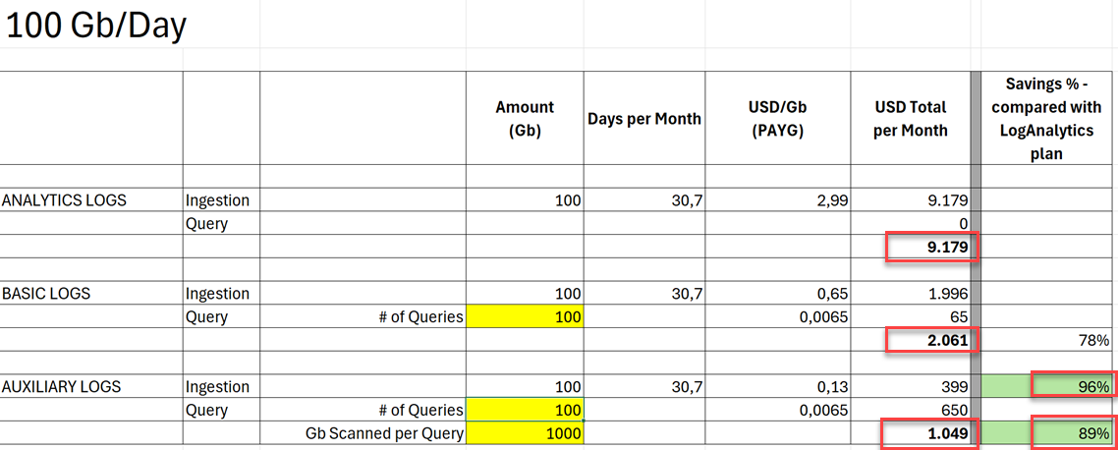
Saving Money with Auxiliary Logs

Slide 21
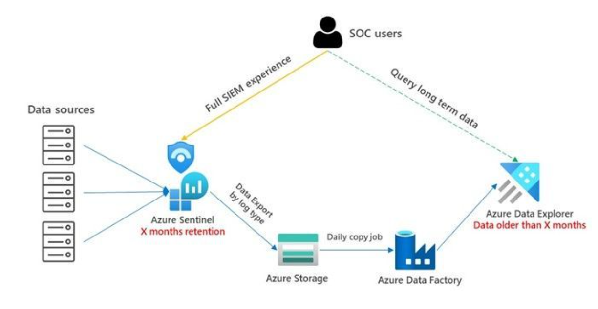
Alternative Long-Term Data Retention (ADX)
How to save $$$ by storing your Syslog and Defender for Endpoint long-term logs in Azure Data Explorer cluster using Azure Data Factory and Azure Storage Account export – while keeping Kusto query functionalities ?
https://mortenknudsen.net/?p=575

